Slide 1
Spanner: Google’s Globally-Distributed Database
Peiqin Gu
July 15, 2013

Slide 2
Outline
Motivation
Major Contributions
Related Work
Solutions
Major Results
Lessons

Slide 3
Motivation
Author
James C.Corbett
Jeffrey Dean
Motivation
Complaints received about Bigtable
Bigtable can be difficult to use for some kinds of applications: those that have complex, evloving schemas, or those that want strong consistency in the presence of wide-are replication.
Many applications at Google have chosen to use Megastore because of its semi-relational data model and support for synchronous replication. (Gmail, Picasa, Calendar, Android Market, AppEngine)
Replication is used for global availability and geographic locality

Slide 4
Major Contributions
Spanner has evolved from a Bigtable-like versioned key-value store into a temporal multi-version database;
Data is stored in schematized semi-relational tables; data is versioned, and each version is automatically timestamped with its commit time; old versions of data are subject to configurable garbage-collection policies;
Spanner supports general-purpose transactions, and provides a SQL-based query language.

Slide 5
Related Work
Paxos state machines
F1: a rewrite of Google’s advertising backend;
Bigtable
Megastore
DynamoDB
Dremel: an interactive data-analysis tool
Percolator
Scatter

Slide 6
Solutions
universe (universe master, placement driver) -> zone (zone master, location proxy, span server)
Key words:
Replica, Paxos state machine, spanserver
Directory (bucket): a set of continguous keys that share a common prefix. A directory is the unit of data placement.

Slide 7
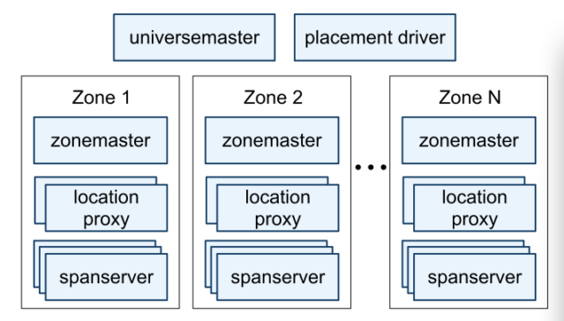
Spanserver organization

Slide 8
Spanserver Software Stack
Each spanserver is responsible for 100~1000 instances of a data structure called tablet.
(key: string, timestamp:int64) string
Unlike Bigtable, Spanner assigns timestamps to data, which makes it more like a multi-version database than a key-value store.
A tablet’s state is stored in a set of B-tree-like files and a write-ahead log.
To support replication, each spanserver implements a single Paxos state machine on top of each tablet.

Slide 9
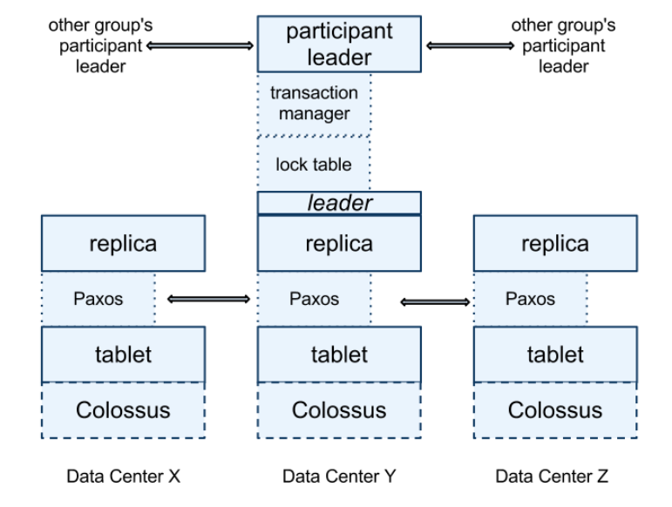
Spanserver software stack

Slide 10
Spanserver software stack
When data is moved between Paxos groups, it is moved directory by directory.

Slide 11
Features
Spanner exposed the following set of data features to applications
A data model based on schematized semi-relational tables
A query language
General-purpose transactions
An application creates one or more databases in a universe. Each database can contain an unlimited number of schematized tables.

Slide 12
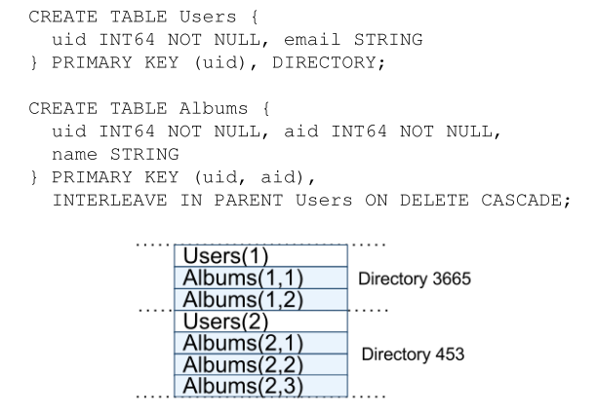
Example Spanner schema for photo metadata

Slide 13
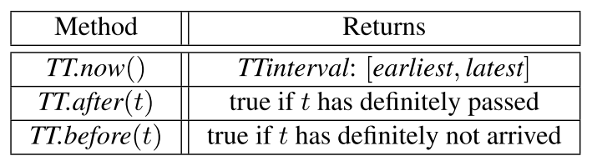
TrueTime
TTinternal: an interval with bounded time uncertainty
Denote the absolute time of an event e by the function t_{abs}(e). TrueTime guarantees that for an invocation tt=TT.now(), tt.earlist ≤t_{abs}(e_{now}) ≤tt.latest

Slide 14
Major Results
The Spanner implementation supports read-write transactions, read-only transactions, snapshot reads.
Work with the F1 team to transition Google’s advertising backend from MySQL to Spanner.

Slide 15
Evaluations replication, transaction, availability
Each spanserver ran on scheduling units of 4GB RAM and 4 cores.
The test database was created with 50 Paxos groups with 2500 directories.
Operations were standalone reads and writes of 4KB.

Slide 16
Lessons
Reifying clock uncertainty in the time API makes it possible to build distributed systems with much stronger time semantics.

